Slide 1








Website Interview
Tell-Tale
Deanissa (06)
Lyra (15)
Lavina (14)

Slide 2
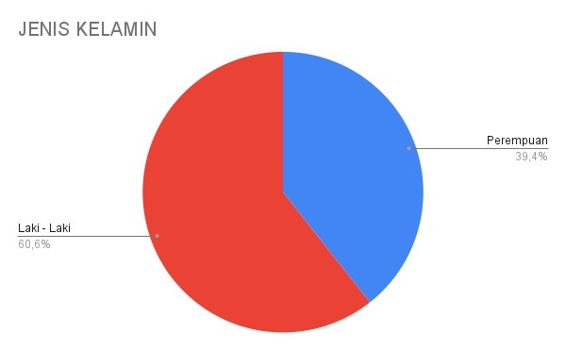

What’s ur gender
Looking at the diagram, it's clear that a significant number of respondents filling out our form are male.
Gender
Female
39,4%
Male
60,6%

Slide 3

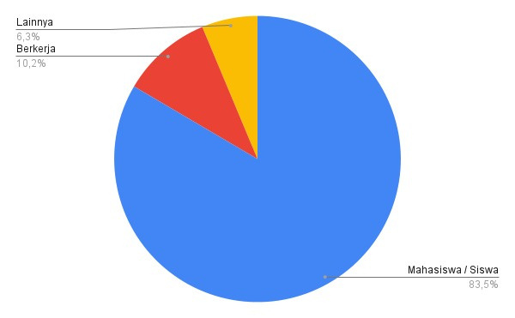

What's your current status
Others
6,3%
Work
10,2%
Student
83,5%
Many of those filling out our form are students, with only 10.2% is an employer

Slide 4
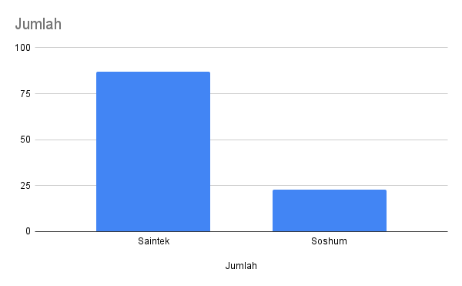

WHAT’S YOUR MAJOR
Major
The majority of our respondents who are students have majors in the field of science and technology.
Saintek
Soshum
Saintek

Slide 5

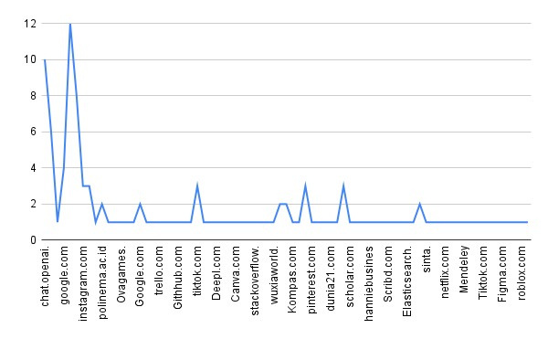

WHAT WEBSITE ARE USED FREQUENTLy
Among the various websites chosen by our respondents, Instagram is the most frequently visited in their daily lives
followed by websites from Chat GPT or OpenAI.

Slide 6
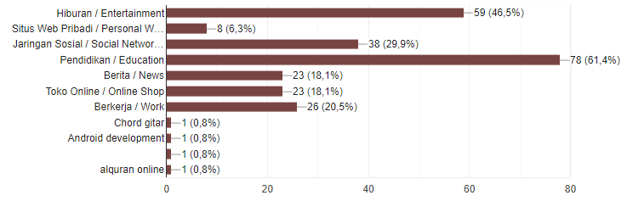

WHAT TYPE OF WEBSITE DO YOU FREQUENTLY USE
Entertainment
Personal Website Networking
Social Networking
Education
Online Shop
Work
Other
Android Development
Other
Al-Qur’an Online
"Since the majority of our respondents are students, educational websites are their top choice, accounting for 37.8%, followed by entertainment websites."

Slide 7
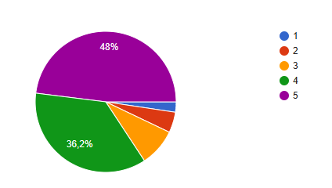
How satisfied are you with the website
Based on the diagram, it can be concluded that our respondents are generally satisfied with the websites they use daily.

Slide 8



Do You Have
Any Question

Slide 9

Thank You
For Your Attention

